Slide 1
GROUP 1 PRESENTATION
Title: Speech-to-Text and NLP Analysis of African-Accented English
Subtitle: An Analysis of the AfriSpeech-200 Dataset
Kwagala Ian 2023-B072-20932
Aijuka Josbert 2023-B071-20758
Babirye Stephania 2023-B071-21283
Nakakande Jennifer W.S 2023-B071-22675
Kyoloobi Edwin 2023-B071-22336
Nakanwagi Pamela Maureen 2023-B071-20462

Slide 2
Project Objective
Content:
  Build a complete speech-to-text pipeline using the AfriSpeech-200 dataset.
  Transcribe audio samples of African-accented English using the Whisper ASR model.
  Apply Natural Language Processing (NLP) tasks to the transcribed text.
  Analyze the results to identify key topics, sentiment patterns, and challenges.

Slide 3
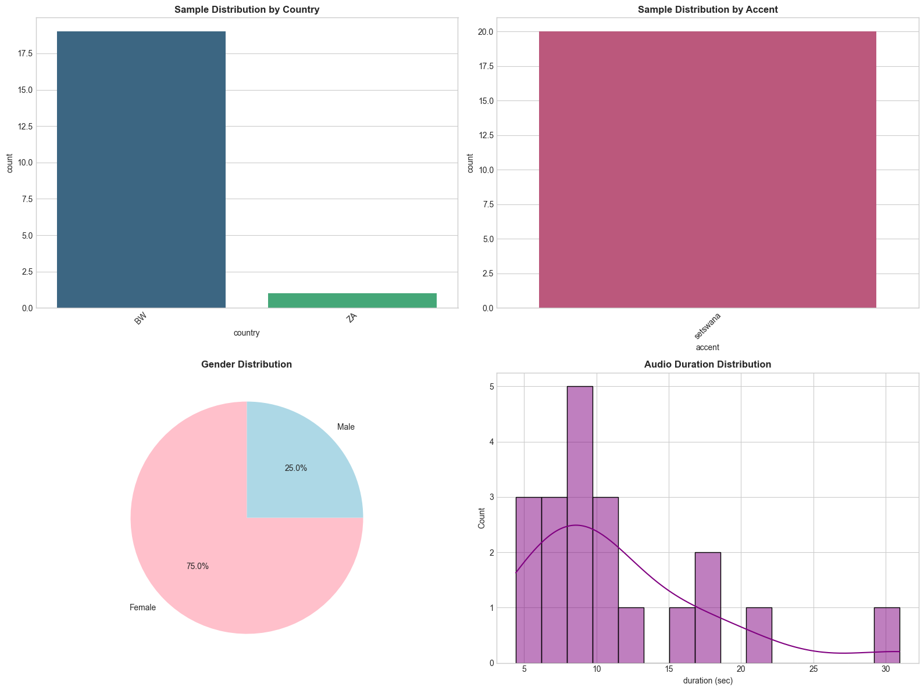
The AfriSpeech-200 Dataset
Title: Understanding the Dataset
Content:
  A pan-African speech corpus with over 200 hours of audio.
  Features English with accents from various African countries (Botswana and SouthAfrica).
  For this analysis, a subset of 20 samples was streamed and analyzed.
Visuals:

Slide 4
Methodology: The Analysis Pipeline
Title: Our Approach
A simple flowchart graphic illustrating the steps:
  1. Data Loading ->
    2. Transcription (Whisper) ->
      3. Text Cleaning ->
        4. NLP Analysis (Sentiment, Keywords) ->
          5. Interpretation

Slide 5
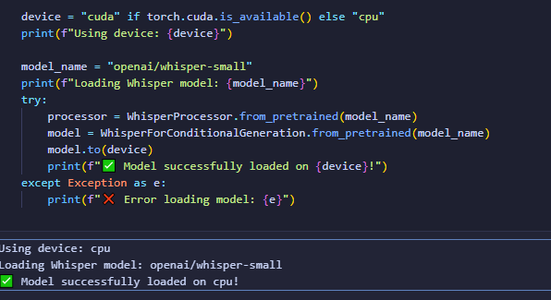
Step 1: Speech Recognition with Whisper
Title: The Transcription Engine: OpenAI's Whisper
Content:
Utilized the openai/whisper-small model, a powerful pre-trained model for Automatic Speech Recognition (ASR).
The model was loaded onto a [cpu/cuda] device for processing.
Each audio sample was resampled to 16,000 Hz as required by the model.
Code Snippet:

Slide 6
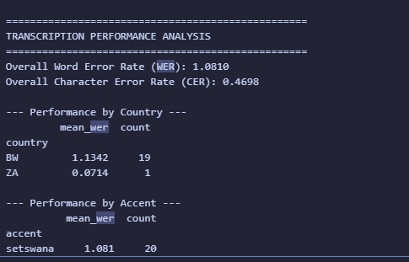
Transcription Performance Analysis
Title: How Well Did Whisper Perform?
Content:
Performance was measured using Word Error Rate (WER) and Character Error Rate (CER).

Slide 7
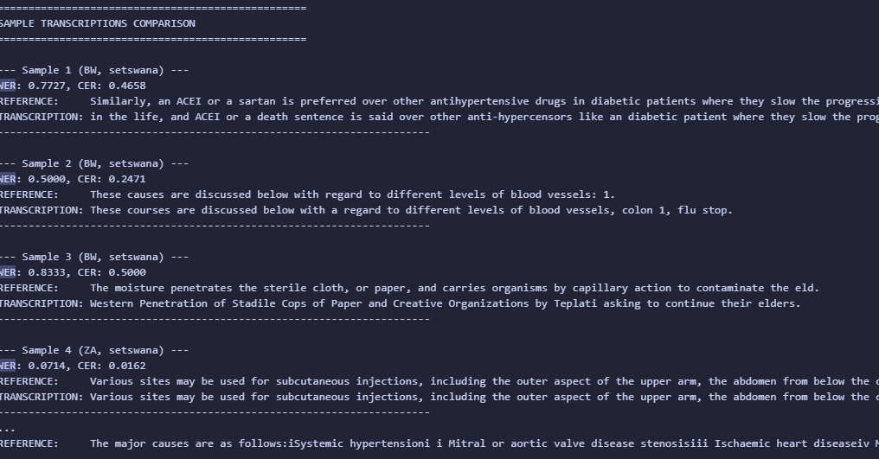
Sample Transcription Comparison
Title: Transcription in Action
Content:
  A side-by-side look at the original text versus the model's output. This highlights common errors like missed words, phonetic mistakes, or punctuation differences.
Output:

Slide 8
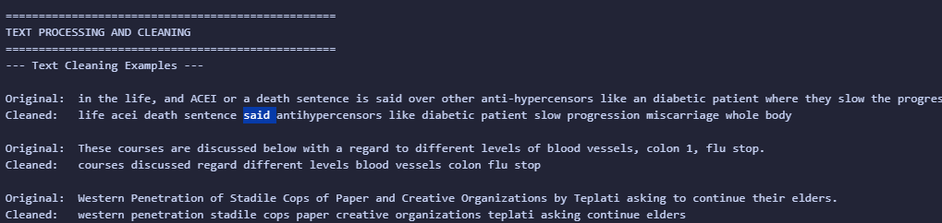
Step 2: Preparing Text for NLP
Title: Text Cleaning and Pre-processing
Content:
Before analysis, the transcribed text was cleaned to improve accuracy:
  Lowercasing: Standardized all text to lowercase.
  Punctuation Removal: Removed all special characters.
  Stopword Removal: Eliminated common English words (e.g., "the", "a", "is").
Output:

Slide 9
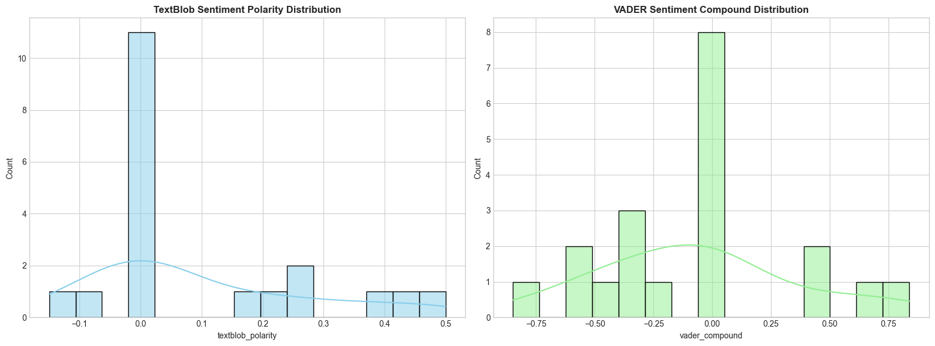
Step 3: Sentiment Analysis
Title: What is the Tone of the Speech?
Content:
Analyzed the sentiment of the transcriptions using two methods:
  TextBlob: Provides a polarity score from -1 (Negative) to +1 (Positive).
  VADER: Designed for social media text, gives a compound score from -1 to +1.
Visuals:

Slide 10
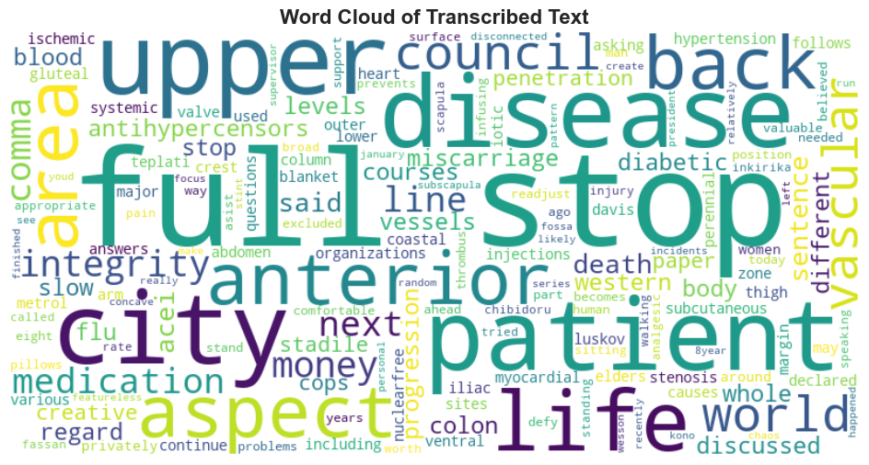
Step 4: Keyword Extraction
Title: Identifying Key Topics with TF-IDF
Content:
Term Frequency-Inverse Document Frequency (TF-IDF) was used to identify the most statistically significant
words in the dataset.
This helps uncover the main topics being discussed.
Visuals:

Slide 11
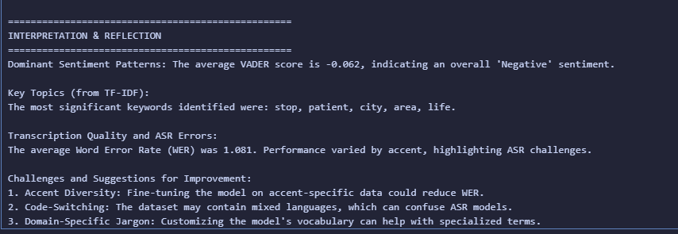
Interpretation: Key Findings
Content:
  Transcription Quality: The average WER of 1.081 shows the model is effective but has challenges, particularly with south afrcia .
  Dominant Sentiment: The overall sentiment of the speech samples was predominantly Negative, with an average VADER score of -0.062
  Key Topics: The most important topics identified were related to, were: stop, patient, city, area, life.

Slide 12
Challenges & Future Work
Title: Challenges and Avenues for Improvement
Content:
Challenge: Accent Diversity: The model's performance varies across different African accents, indicating a
need for more diverse training data.
Challenge: Code-Switching & Jargon: Mixed language and domain-specific terms can confuse the ASR model.
Suggestion for Improvement: Fine-tune the Whisper model on a larger, accent-specific subset of the
AfriSpeech-200 data to reduce WER.
Suggestion for Improvement: Develop a custom vocabulary to handle specialized or non-English terms
present in the audio

Slide 13
Q&A
Thank You
Questions?

